Slide 1
SHAPES Project and the inclusion of older persons with deafblindness
Lucia D’Arino, WFDB Program Advisor
WFDB CoSP16 Side Event, June 14th 2023

Slide 2
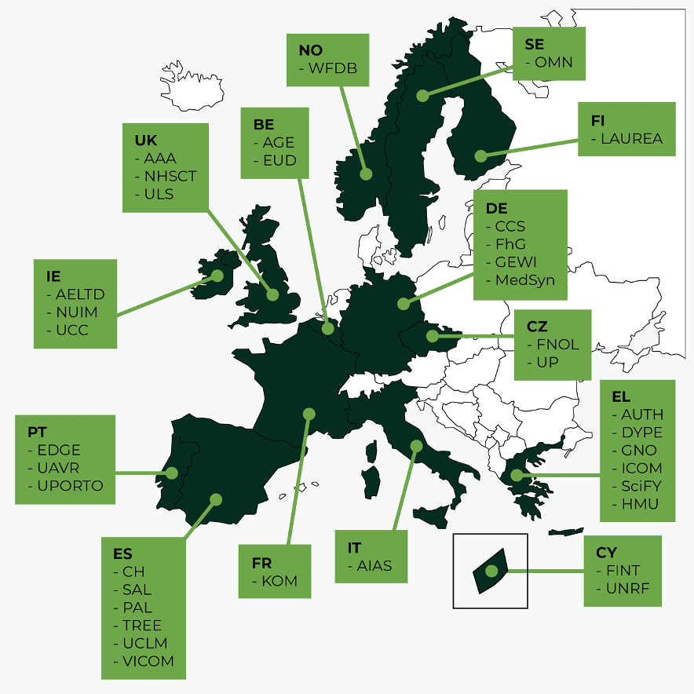
SHAPES in Numbers
48 month project
November 2019 - October 2023
300 staff
36 organisations
14 European Countries
10 Work Packages.
Engages 2000 older adults across 15 pilot sites
€21m in EU-funding.
6 Reference Sites of the European Innovation Partnership (EIP) on Active and Healthy Ageing (AHA),

Slide 3
The Vision
The SHAPES Innovation Action (IA) will build, pilot and deploy a large-scale, EU-standardised, open platform and develop or improve digital technologies such as assistive robots, wearables, mobile Apps
To facilitate long-term healthy and active ageing and the maintenance of a high-quality of life, in the community.

Slide 4
WFDB’s role in project
Bring to SHAPES the perspective of the deafblind community showcasing its diversity
Contribute with WFDB’s understanding of persons with deafblindness and their diverse needs, in terms of health, technology and accessibility
Advocate for the inclusion and rights of persons with deafblindness using the CRPD as a basis
Coordinate with WFDB members the involvement of older persons with deafblindness

Slide 5
WFDB’s general objectives in the project
Be involved in all key processes of the project
Collect data on the situation and realities of older persons with deafblindness
Raise awareness on deafblindness as a distinct disability
Ensure the platform and digital solutions are inclusive of persons with deafblindness
Study ways in which technology can prevent exclusion and isolation
Disseminate the results both internally within SHAPES and externally

Slide 6
Examples of our work
End-user testing of platform and digital solutions
Interviews and focus groups with persons with deafblindness
Production of reports documenting challenges and recommendations
Section on older persons with deafblindness in 2nd Global report
3 WFDB-SHAPES workshops have been held
Publication of internal reports on how to improve accessibility
Continuous assessment on SHAPES resources and all promotional materials

Slide 7
Publications
2020: “COVID-19 as social disability – the opportunity of social empathy for empowerment” (co-authored)
2021: “The Red and White Cane: Obstacles and Barriers” (SHAPES Story)
2022: “A Window to the World: Guide Interpreters and Tactile Communication” (SHAPES Story)
2022: “Cultivating Neighbourhoods That Care: A manifesto for change” (co-authored)
2022: “Implementation of a pan-European ecosystem and an interoperable platform for Smart and Healthy Ageing in Europe: An Innovation Action research protocol” (co-authored)
2023: “2nd Global Report on the situation of persons with deafblindness” (includes SHAPES as a case study)

Slide 8
Why is SHAPES an example of a good practice?
2 disability organisations are consortium partners
WFDB was involved from early planning stages
Reasonable acommodations are reflected in the budget (i.e.: sign language interpreters)
Accessibility meetings are often held
Inclusion and accessibility has been adopted as a cross-cutting requirement

Slide 9
Why is SHAPES an example of a good practice? (2)
WFDB has maintained ownership of the project and decision-making power
The disability community is connected with hundreds of key stakeholders around the EU
Direct involvement and participation of end users with different types of disabilities
Increased awareness on disability, inclusion, accessibility internally and externally
Collects data and information on older persons with disabilities (i.e..: 2nd Global Report and Production of a Global Report on older persons with deafblindness)

Slide 10
Thank you! Questions?
Contact person inside WFDB: Lucia D’Arino (projects@wfdb.eu)
Official website: www.shapes2020.eu
Twitter: @H2020Shapes

