Slide 1
Smart and Healthy Ageing through People Engaging in supportive Systems
Anastasia Campbell
Project Manager
Assisting Living and Learning (ALL) Institute, Maynooth University, Ireland
6 June 2023

Slide 2
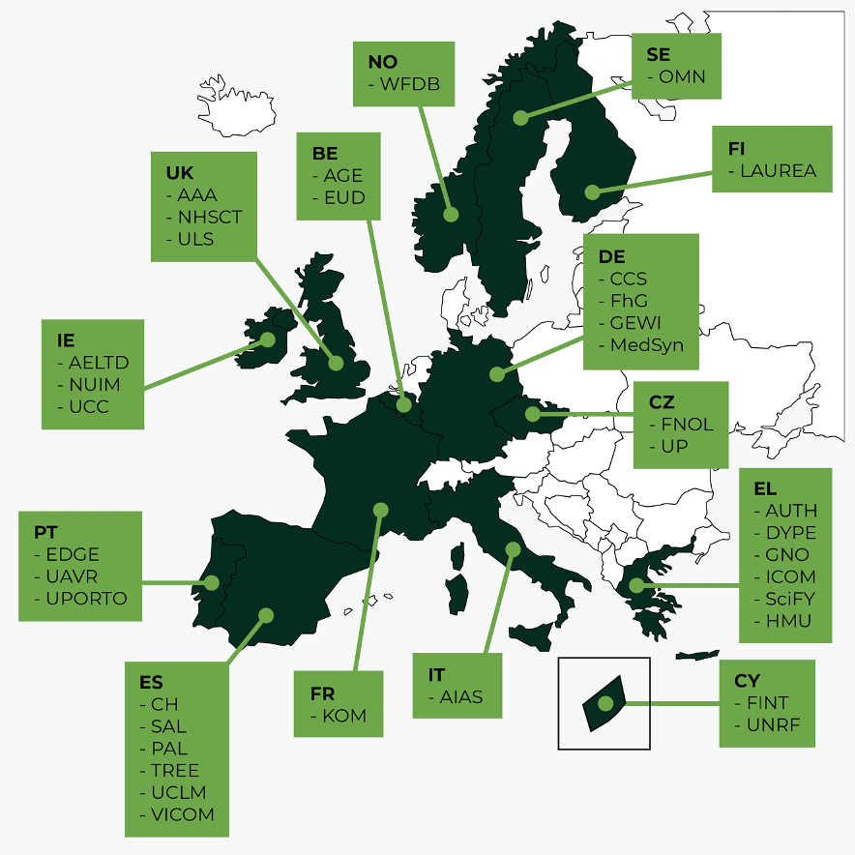
SHAPES in Numbers
48 month project
November 2019 - October 2023
300 staff
36 organisations
14 Countries
10 Work Packages.
Engages 2000 older adults across 15 pilot sites
€21m in funding.
6 Reference Sites of the European Innovation Partnership (EIP) on Active and Healthy Ageing (AHA),

Slide 3
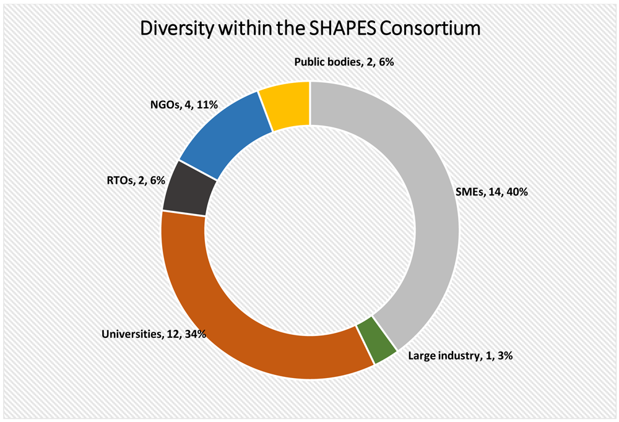
Figure 2. Breakdown of fields of expertise within the SHAPES Consortium.
Seidel K, Labor M, Lombard-Vance R et al. Implementation of a pan-European ecosystem and an interoperable platform for Smart and Healthy Ageing in Europe: An Innovation Action research protocol [version 1]. Open Res Europe 2022, 2:85 (doi: 10.12688/openreseurope.14827.1)
Notes:
Figure 2. Breakdown of fields of expertise within the SHAPES Consortium.
Seidel K, Labor M, Lombard-Vance R et al.. Implementation of a pan-European ecosystem and an interoperable platform for Smart and Healthy Ageing in Europe: An Innovation Action research protocol [version 1]. Open Res Europe 2022, 2:85 (doi: 10.12688/openreseurope.14827.1)

Slide 4
SHAPES DIGITAL TECHNOLOGIES: Include assistive robots, eHealth sensors and wearables, Internet of Things (IoT)-enabled devices and mobile applications.
THE VISION
The SHAPES Innovation Action (IA) will build, pilot and deploy a large-scale, EU-standardised, open platform.
To facilitate long-term healthy and active ageing and the maintenance of a high-quality of life, in the community.
SHAPES ECOSYSTEM: A network of relevant users and key stakeholders working together to scale-up Platform and digital technologies.
SHAPES MARKETPLACE: Seeks to connect demand and supply across health and social care delivery, and to facilitate the co-creation of affordable, effective and trustworthy solutions.
SHAPES RECOMMENDATIONS: Provide guidelines, a roadmap and an action plan, including a set of priorities dedicated to standardisation, to support key EU stakeholders to foster the large-scale deployment and adoption of digital technologies and new integrated care services in Europe.

Slide 6
The Pilot Themes
Caring for Older Individuals with Neurodegenerative Diseases
Improving In-Home and Community-based Care
Physical Rehabilitation at Home
Smart Living Environment for healthy ageing at Home
Psycho-social and Cognitive Stimulation Promoting Wellbeing
Cross-border Health Data Exchange Supporting Mobility and Accessibility for Older Individuals
Medicine Control and Optimisation

Slide 7
SHAPES and WFDB
Reciprocal
benefits to
SHAPES and the World Federation of the Deafblind
SHAPES
WFDB

Slide 8
SHAPES and WFDB
The European population is ageing with life expectancy exceeding 80 years in most European states.
Ageing across Europe includes increased likelihood of Deafblindness, deafness, blindness.
The SHAPES project aims to empower older people and facilitate long term healthy and active ageing.
WFDB brings to SHAPES the perspective of the deaf and blind community which is a huge advantage for the SHAPES project to be able to ensure inclusion and accessibility of persons with Deafblindness.
SHAPES brings to WFDB the opportunity to be at the forefront of pan-European technology development, its governance and the chance to influence policies and best practices internationally.
Horizon projects are about the equalisation of opportunities across Europe – that means opportunities for Deafblind persons too.
We must all advocate for future projects on ageing in Europe to include Deafblindness to assess accessibility and equality of opportunity for Deafblind persons to meaningfully participate in society.

Slide 9
SHAPES
5th September 2023 13:00 – 14:30 CET
The SHAPES project will be presenting to the European Parliament
SHAPES –equalizing opportunities for older people in Europe’s digital decade

Slide 10
Smart and Healthy Ageing through People Engaging in supportive Systems
shapes.info@mu.ie

